Slide 1

CMMI
Overview
Quality
Frameworks

Slide 2
Outline
Introduction
High level overview of CMMI
Questions and comments
Slide <number> of 146

Slide 3
What is CMMI?
CMMI (Capability Maturity Model Integration) is a proven industry framework to improve product quality and development efficiency for both hardware and software
  Sponsored by US Department of Defence in cooperation with Carnegie Mellon University and the Software Engineering Institute (SEI)
  Many companies have been involved in CMMI definition such as Motorola and Ericsson
  CMMI has been established as a model to improve business results
CMMI, staged, uses 5 levels to describe the maturity of the organization, same as predecessor CMM
  Vastly improved version of the CMM
  Emphasis on business needs, integration and institutionalization
Slide <number> of 146

Slide 4
How can CMMI help?
CMMI provides a way to focus and manage hardware and software development from product inception through deployment and maintenance.
  ISO/TL9000 are still required. CMMI interfaces well with them. CMMI and TL are complementary - both are needed since they address different aspects.
    ISO/TL9000 is a process compliance standard
    CMMI is a process improvement model
Behavioral changes are needed at both management and staff levels. Examples:
  Increased personal accountability
  Tighter links between Product Management, Development, SCN, etc.
Initially a lot of investment required – but, if properly managed, we will be more efficient and productive while turning out products with consistently higher quality.
Slide <number> of 146

Slide 5
CMMI Models within the Framework
Models:
  Systems Engineering + Software Engineering (SE/SW)
  Systems Engineering + Software Engineering + Integrated Product and Process Development (IPPD)
  Systems Engineering + Software Engineering + Integrated Product and Process Development + Supplier Sourcing (SS)
  Software Engineering only
Representation options:
  Staged
  Continuous
The CMMI definition of “Systems Engineering” -
  “The interdisciplinary approach governing the total technical and managerial effort required to transform a set of customer needs, expectations and constraints into a product solution and to support that solution throughout the product’s life.” This includes both hardware and software.
Slide <number> of 146

Slide 6
CMMI Staged Representation - 5 Maturity Levels
Level 5
Process performance continually improved through incremental and innovative technological improvements.
Optimizing
Level 4
Quantitatively
Managed
Processes are controlled using statistical and other quantitative techniques.
Process Maturity
Level 3
Defined
Processes are well characterized and understood. Processes, standards, procedures, tools, etc. are defined at the organizational (Organization X ) level. Proactive.
Level 2
Managed
Processes are planned, documented, performed, monitored, and controlled at the project level. Often reactive.
Level 1
Initial
Processes are unpredictable, poorly controlled, reactive.
Slide <number> of 146

Slide 7
Maturity Level 1
Initial
Maturity Level 1 deals with performed processes.
Processes are unpredictable, poorly controlled, reactive.
The process performance may not be stable and may not meet specific objectives such as quality, cost, and schedule, but useful work can be done.
Slide <number> of 146

Slide 8
Maturity Level 2
Managed at the Project Level
Maturity Level 2 deals with managed processes.
A managed process is a performed process that is also:
  Planned and executed in accordance with policy
  Employs skilled people
  Adequate resources are available
  Controlled outputs are produced
  Stakeholders are involved
  The process is reviewed and evaluated for adherence to requirements
Processes are planned, documented, performed, monitored, and controlled at the project level. Often reactive.
The managed process comes closer to achieving the specific objectives such as quality, cost, and schedule.
Slide <number> of 146

Slide 9
Maturity Level 3
Defined at the Organization Level
Maturity Level 3 deals with defined processes.
A defined process is a managed process that:
  Well defined, understood, deployed and executed across the entire organization. Proactive.
  Processes, standards, procedures, tools, etc. are defined at the organizational (Organization X ) level. Project or local tailoring is allowed, however it must be based on the organization’s set of standard processes and defined per the organization’s tailoring guidelines.
Major portions of the organization cannot “opt out.”
Slide <number> of 146

Slide 10
Behaviors at the Five Levels
Maturity Level
Process Characteristics
Behaviors
Focus is on continuous
quantitative improvement
Focus on "fire prevention";
Optimizing
improvement anticipated and
desired, and impacts assessed.
Quantitatively
Managed
Process is measured
and controlled
Greater sense of teamwork and inter-
dependencies
Process is characterized
for the organization and
is proactive
Reliance on defined process. People understand, support and follow the process.
Defined
Process is characterized
for projects and is often
reactive
Over reliance on experience of good
Managed
people – when they go, the process
goes. “Heroics.”
Process is unpredictable,
poorly controlled, and
reactive
Focus on "fire fighting";
Initial
effectiveness low – frustration high.
Slide <number> of 146

Slide 11
CMMI Components
Within each of the 5 Maturity Levels, there are basic functions that need to be performed – these are called Process Areas (PAs).
For Maturity Level 2 there are 7 Process Areas that must be completely satisfied.
For Maturity Level 3 there are 11 Process Areas that must be completely satisfied.
Given the interactions and overlap, it becomes more efficient to work the Maturity Level 2 and 3 issues concurrently.
Within each PA there are Goals to be achieved and within each Goal there are Practices, work products, etc. to be followed that will support each of the Goals.
Slide <number> of 146

Slide 12
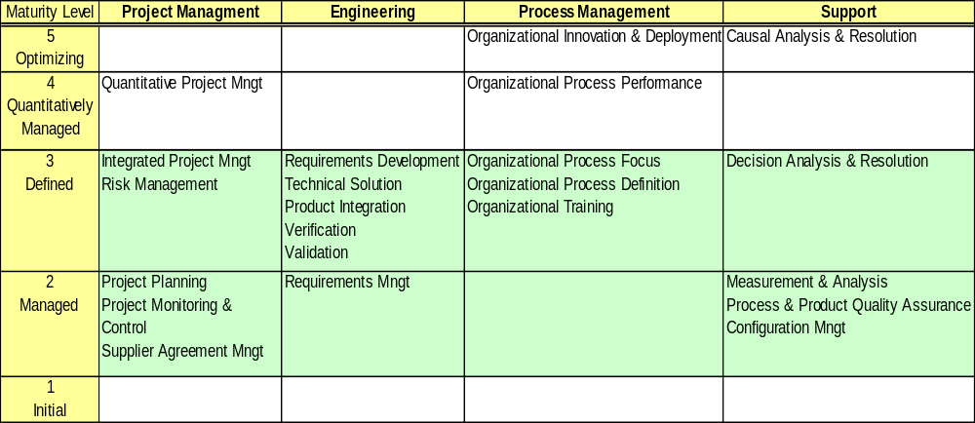
CMMI Process Areas
Slide <number> of 146

Slide 13
CMMI Terminology & Structure
Maturity Levels (1
-
5)
Process Area 1
Process Area 2
Process Area n
Required. Specific for each process area.
Specific
Generic
Required. Common across all process areas.
Goals
Goals
Common Features
Commitment
Ability
Directing
Verifying
to Perform
to Perform
Implementation
Implementation
Specific
Required
Required
Generic
Informative
Informative
Practices
Practices
Sub practices
, typical work products,
Sub practices
, typical work products,
discipline amplifications, generic
discipline amplifications, generic
practice elaborations, goal and
practice elaborations, goal and
practice titles, goal and practice notes,
practice titles, goal and practice notes,
and references
and references
Slide <number> of 146

Slide 14
Example
For the Requirements Management Process Area:
An example Goal (required):
“Manage Requirements”
An example Practice to support the Goal (required):
“Maintain bi-directional traceability of requirements”
Examples (suggested, but not required) of typical Work Products might be
Requirements traceability matrix or
Requirements tracking system
Slide <number> of 146

Slide 15
Yet another CMMI term: Institutionalization
This is the most difficult part of CMMI implementation and the portion where managers play the biggest role and have the biggest impact
Building and reinforcement of corporate culture that supports methods, practices and procedures so they are the ongoing way of business……..
  Must be able to demonstrate institutionalization of all CMMI process areas for all organizations, technologies, etc.
Required for all Process Areas
Slide <number> of 146

Slide 16
CMMI Resources
Software Engineering Institute's CMMI website:
  http://www.sei.cmu.edu/cmmi/
Slide <number> of 146

